Slide 1
Coursera Capstone Project
The Battle of Neighborhoods
Nisa Momin
August 2020

Slide 2
Location recommendation for Chinese Restaurant in Singapore

Slide 3
TOC
Introduction/Business Problem
Problem description and background
Target audience
Data
Sources and usage
Methodology
Kmeans Clustering
Result /Discussion /Conclusion
Acknowledgement

Slide 4
Introduction

Slide 5
Problem Description
The objective of this project is to find a suitable location for an entrepreneur to open a restaurant in Singapore. By using the data science methods and machine learning algorithms such as clustering, this project aims to provide a solution to answer this business problems: In Singapore if an entrepreneur wants to open a restaurant which location should be considered?

Slide 6
Target Audience
The Target audience for this project would be the working Singaporeans who want to eliminate hassle of cooking from their busy lives and at the same time can enjoy good food. Also being a leisure activity, we would target people who love to dine in restaurants.

Slide 7
Data

Slide 8
Sources and usage
To solve the problem, I will need the following data:
List of Neighborhoods in Singapore
Latitude and longitude of these districts
Venue data related to Chinese restaurants in different districts
To solve the problem, I will need the following data:
List of Neighborhoods in Singapore
Latitude and longitude of these districts
Venue data related to Chinese restaurants in different districts

Slide 9
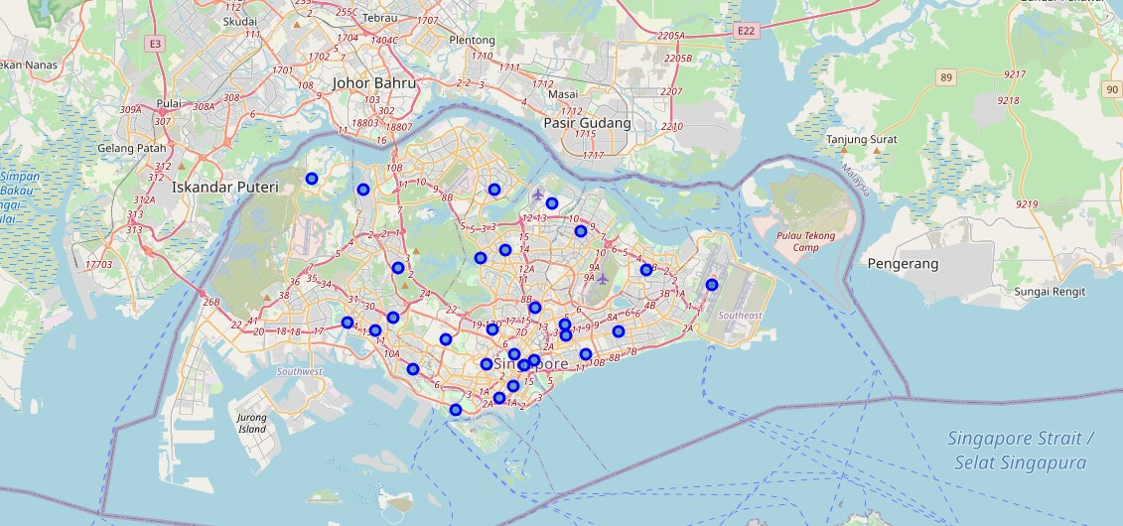

Slide 10
Methodology

Slide 11
Methodolgy
How can we learn?
Therefore, we will use Kmeans Clustering to learn and predict number of the Chinese restaurant in a district by providing the venues information of Singapore. Venues information is discovered from Foursquare API.
explore and cluster the Postal Districts in Singapore
Then, I will the build model to predict the number of Chinese restaurants in the city-based country and compare with exiting number of Chinese restaurants and a potential place to start the business!

Slide 12
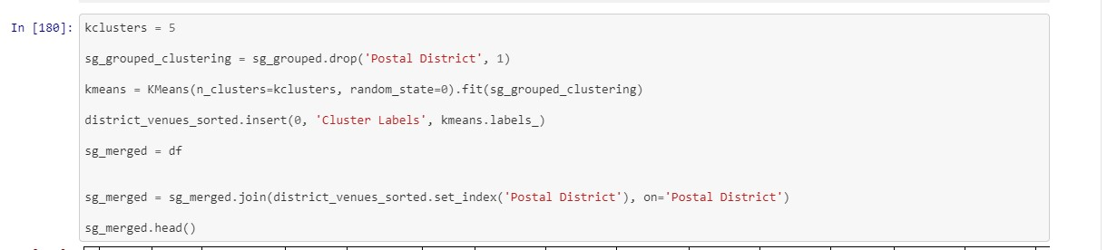

Slide 13
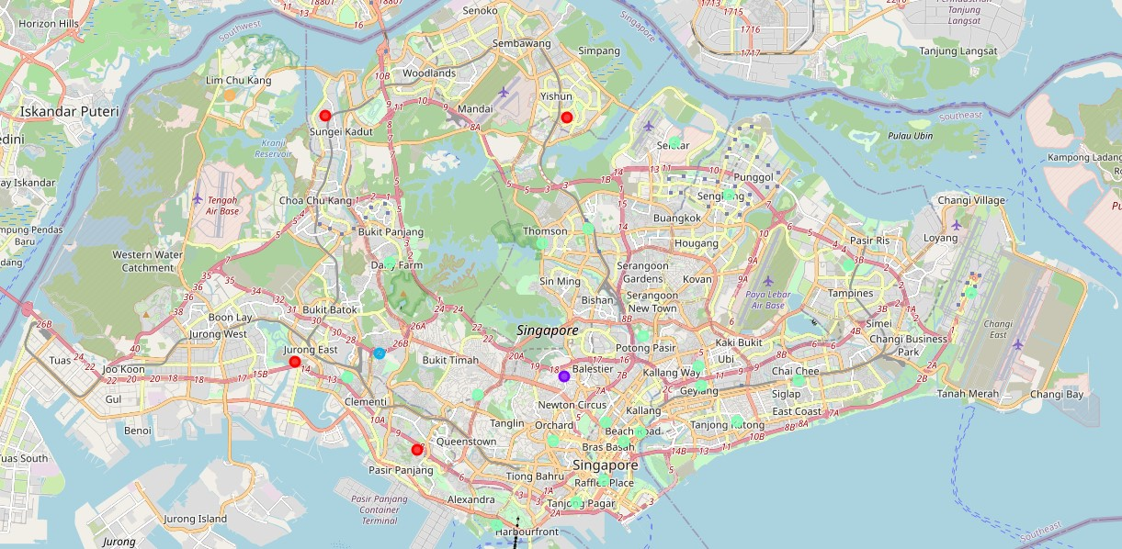

Slide 14
Notebook Link

Slide 15
https://github.com/nisamomin/capstone-project/blob/master/Capstone%20Project%20Notebook%20.ipynb

Slide 16
Results and Discussions

Slide 17
Results and Discussions
From our analysis, the most common venues are cafés and restaurants so cluster 1 seems to be the hotspot for opening a Chinese Restaurant as it’s a main residential and commercial area and a potential business place. This cluster includes most of the districts in Singapore as a potential place to open a business giving more options to the owner to look for their own convenience and comfort.
Further analysis is required on the following potential aspects
Parking availability
Zoning Licenses and liquor licenses
Data regarding existing properties for opening the restaurant

Slide 18
Conclusions

Slide 19
Conclusions
This notebook can be used a s starting point for potential restaurant owner to shortlist areas for opening a restaurant. Due to extensive analysis and availability of data, the notebook can serve the owner to also look for the alternative cuisines instead of only looking to open a Chinese restaurant.

Slide 20
References
Notebook: https://github.com/nisamomin/capstone-project/blob/master/Capstone%20Project%20Notebook%20.ipynb
Report: https://github.com/nisamomin/capstone-project/blob/master/Report.docx

